Slide 1


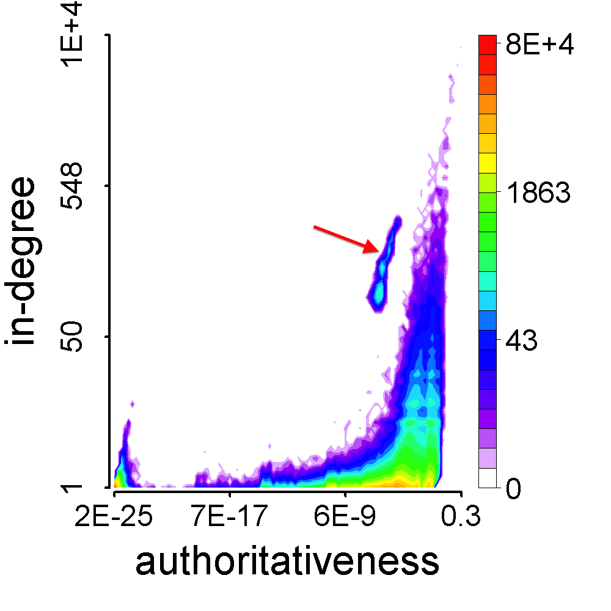
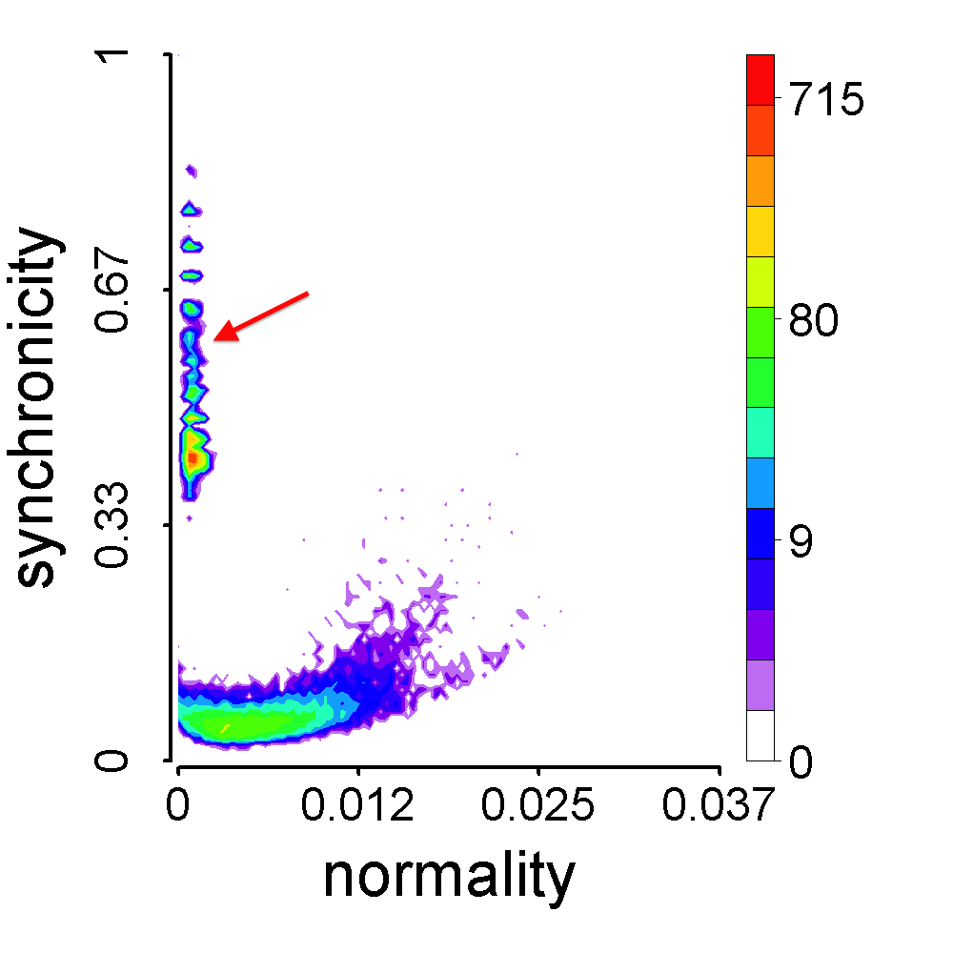
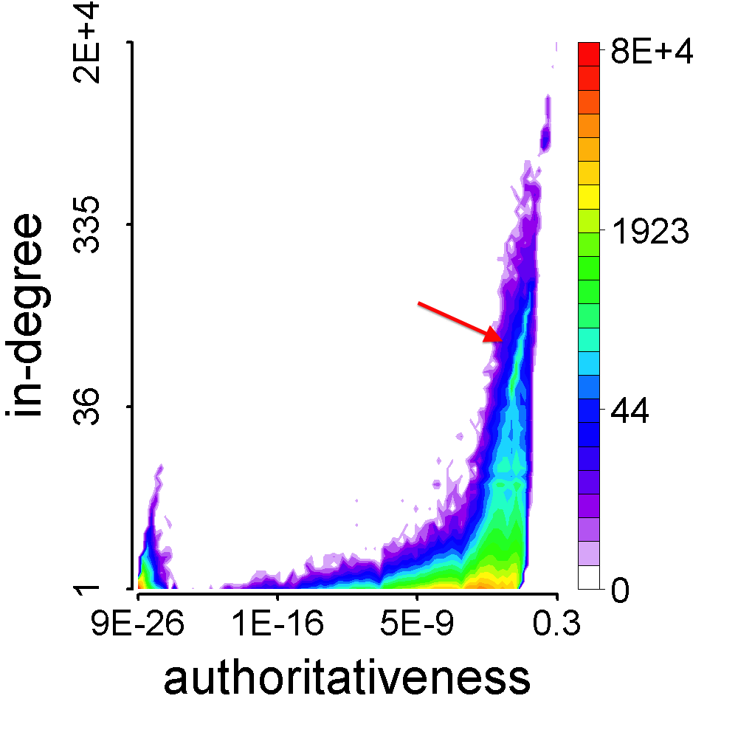
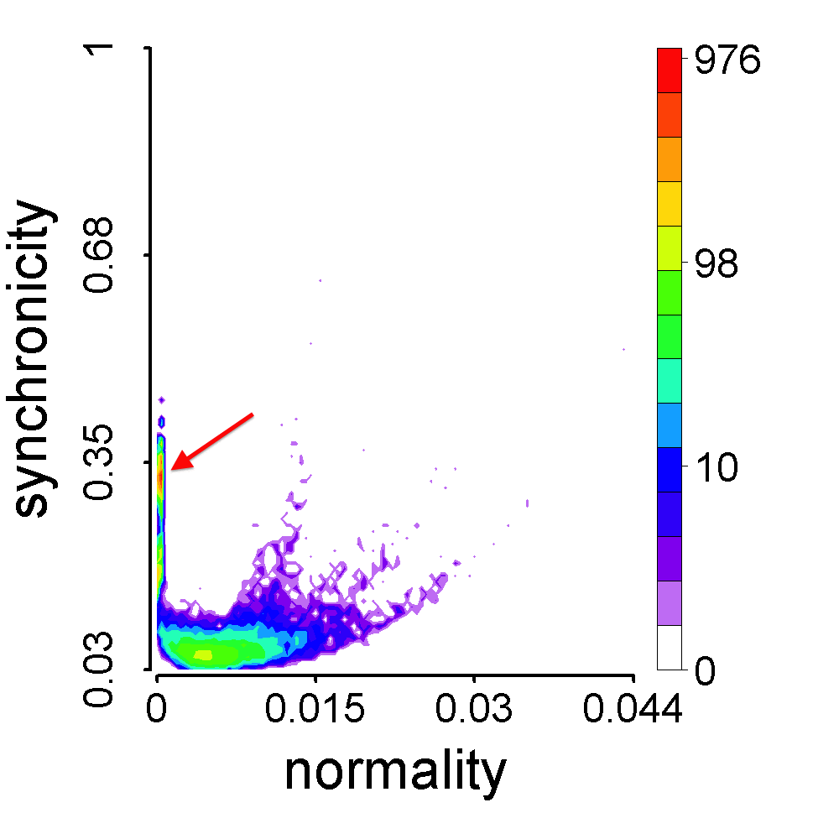
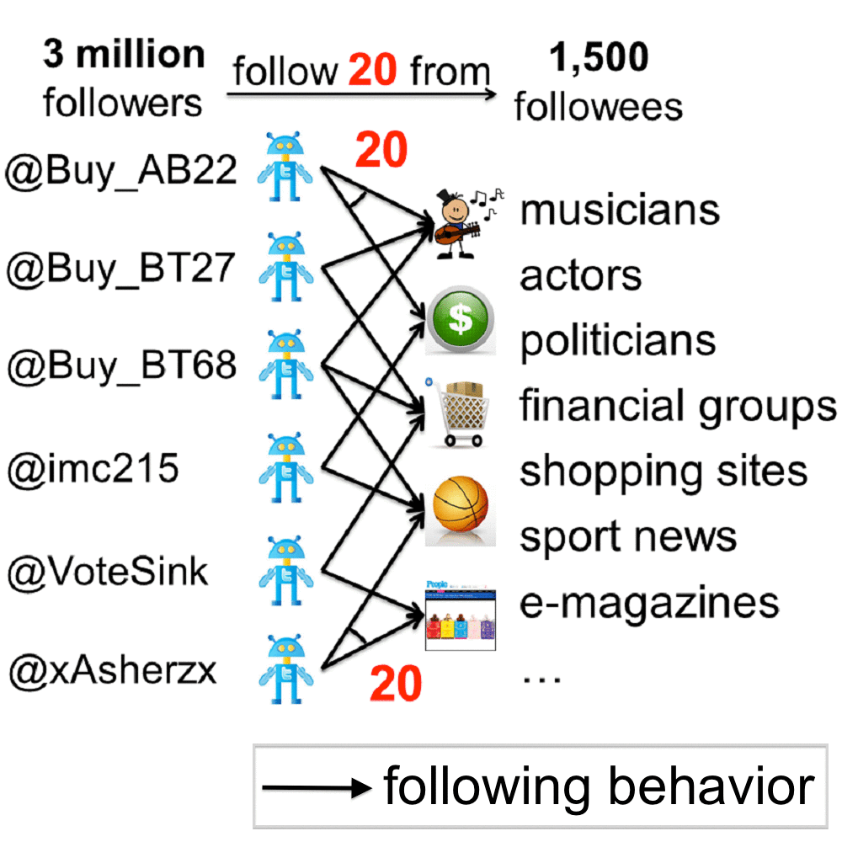
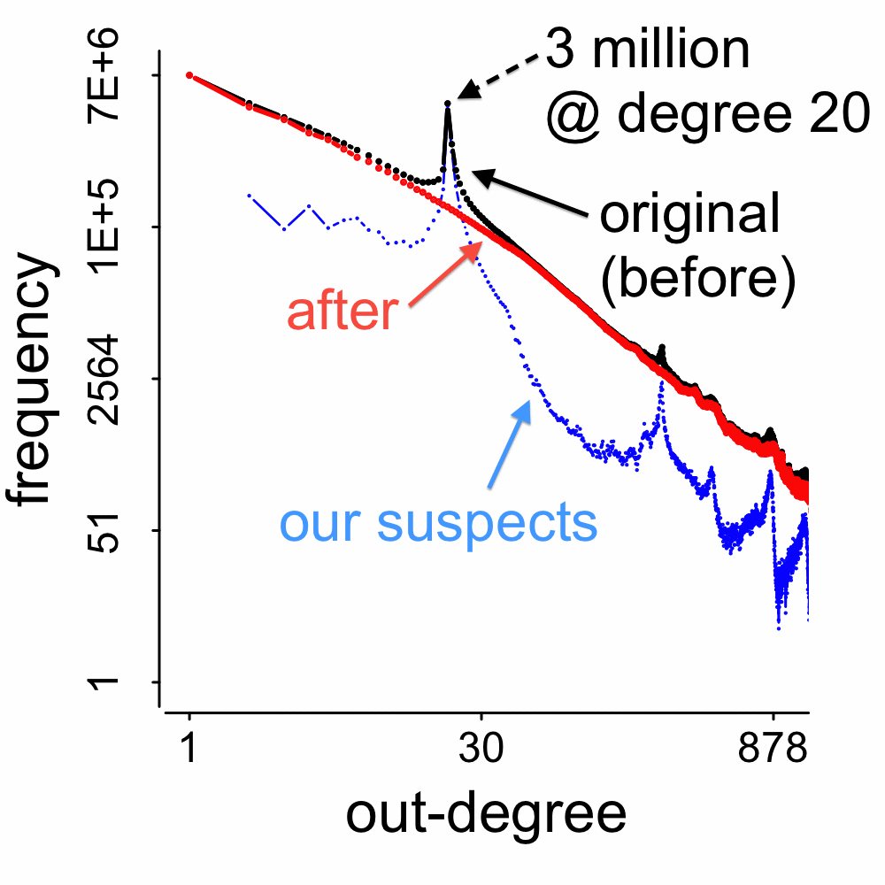
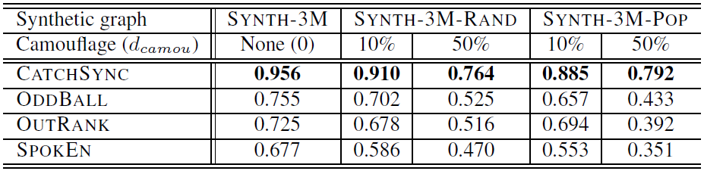
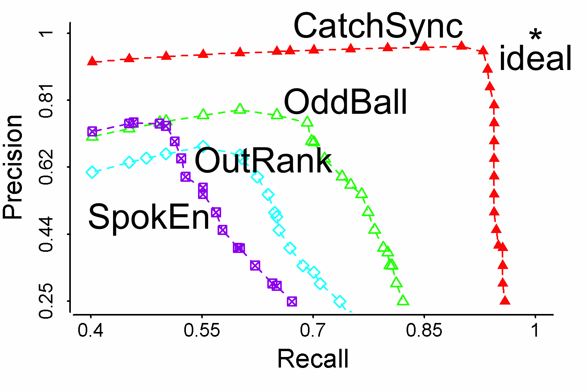
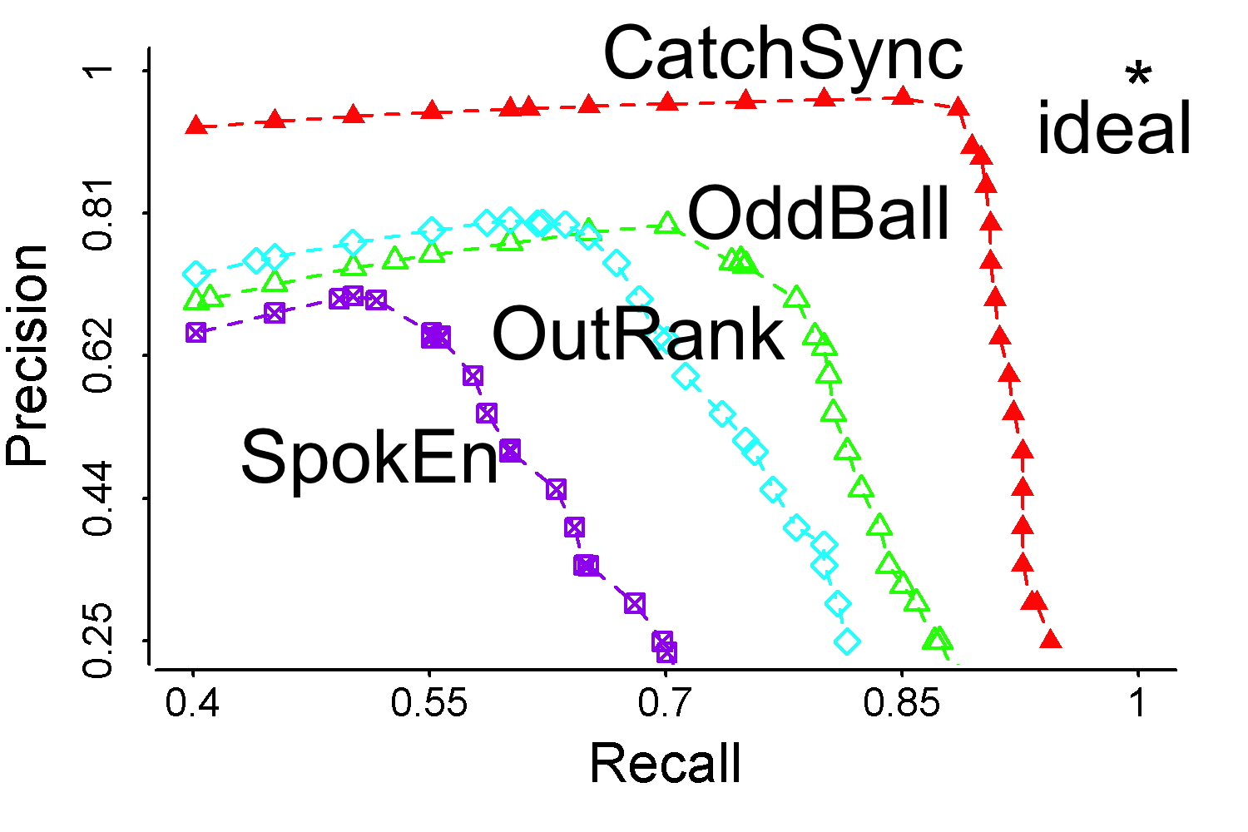
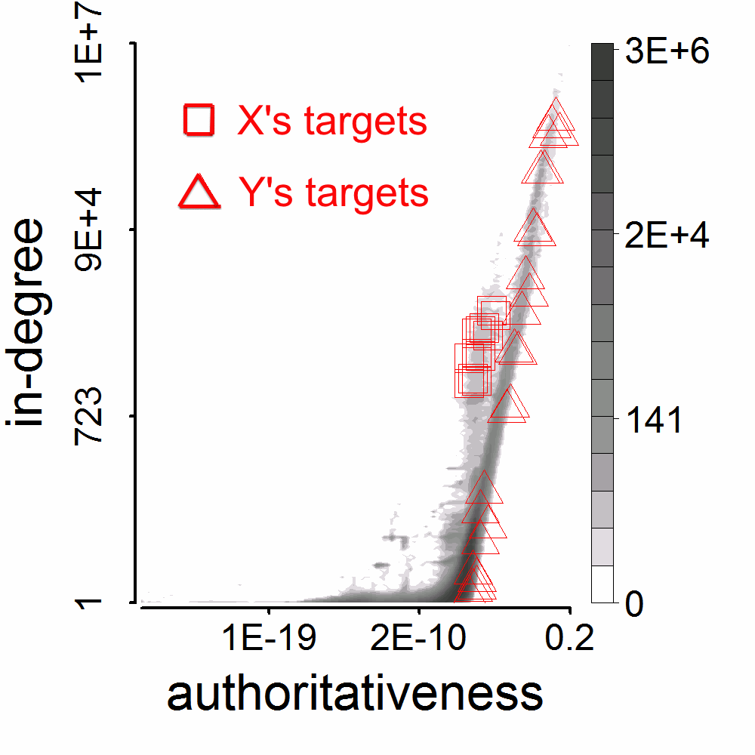
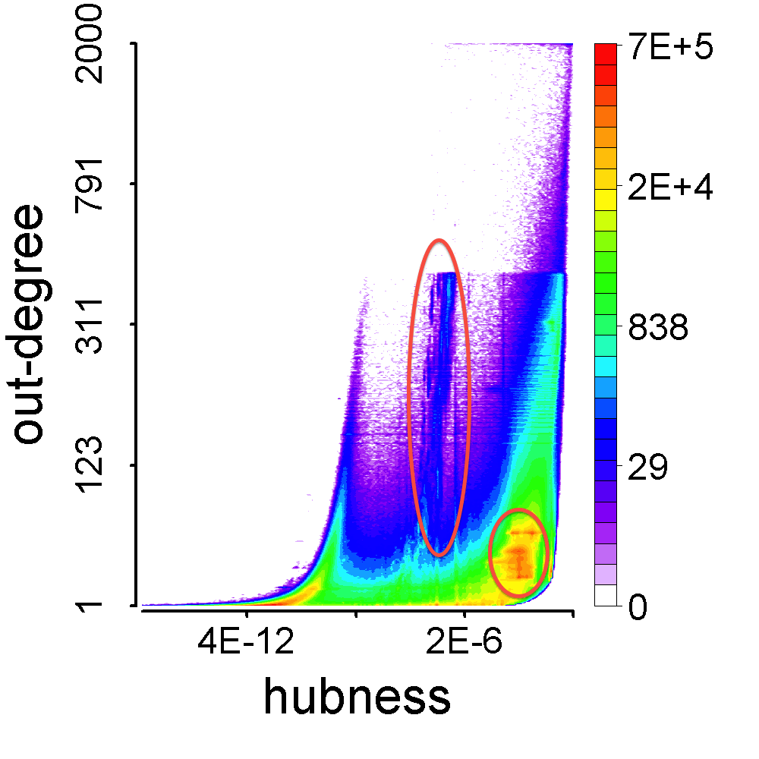
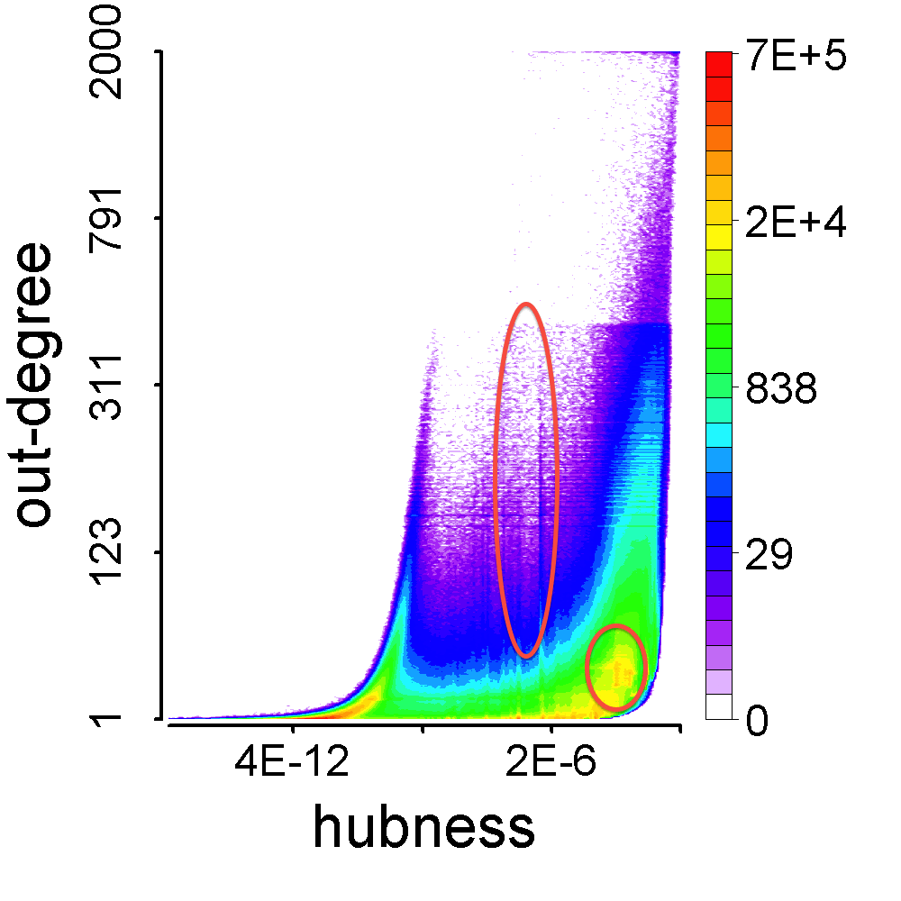
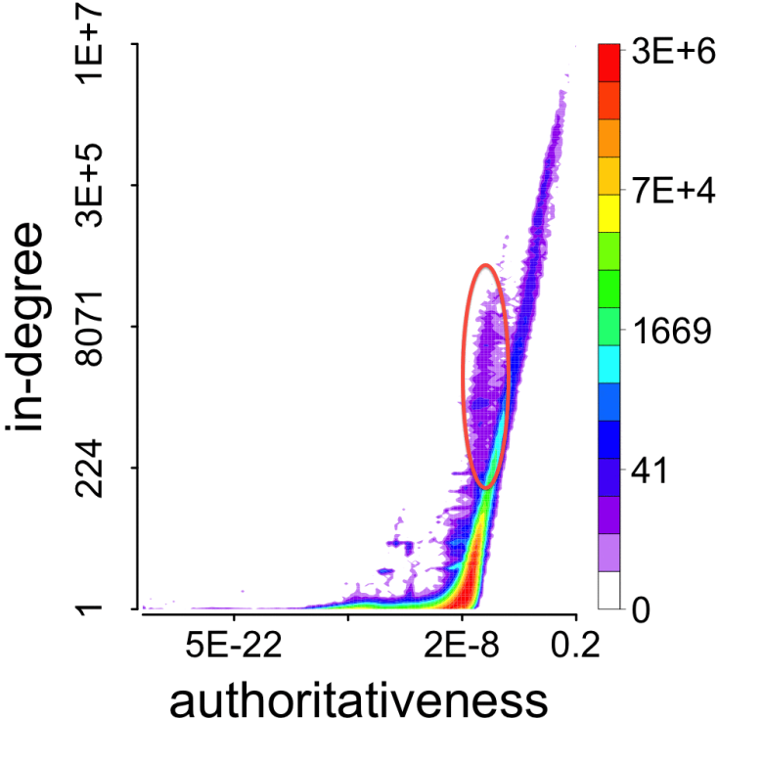
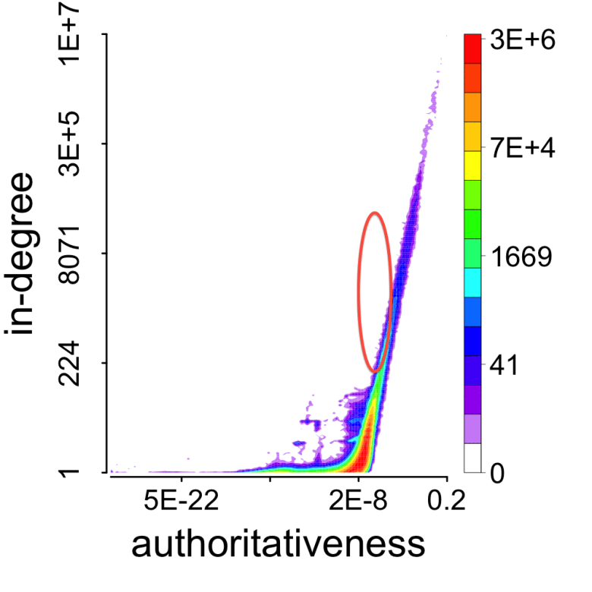
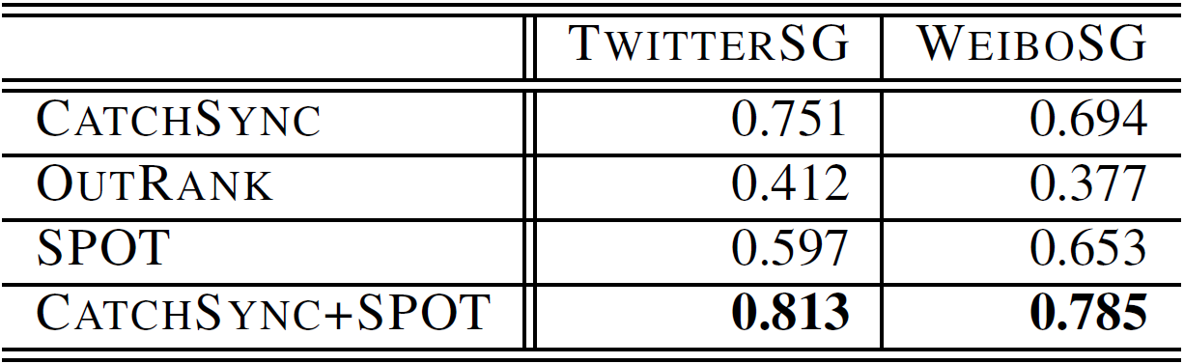
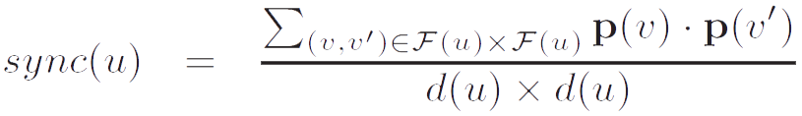
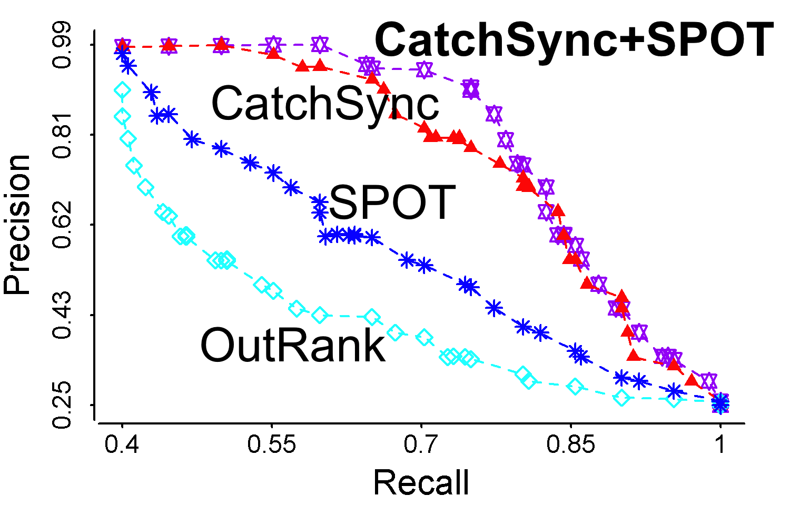
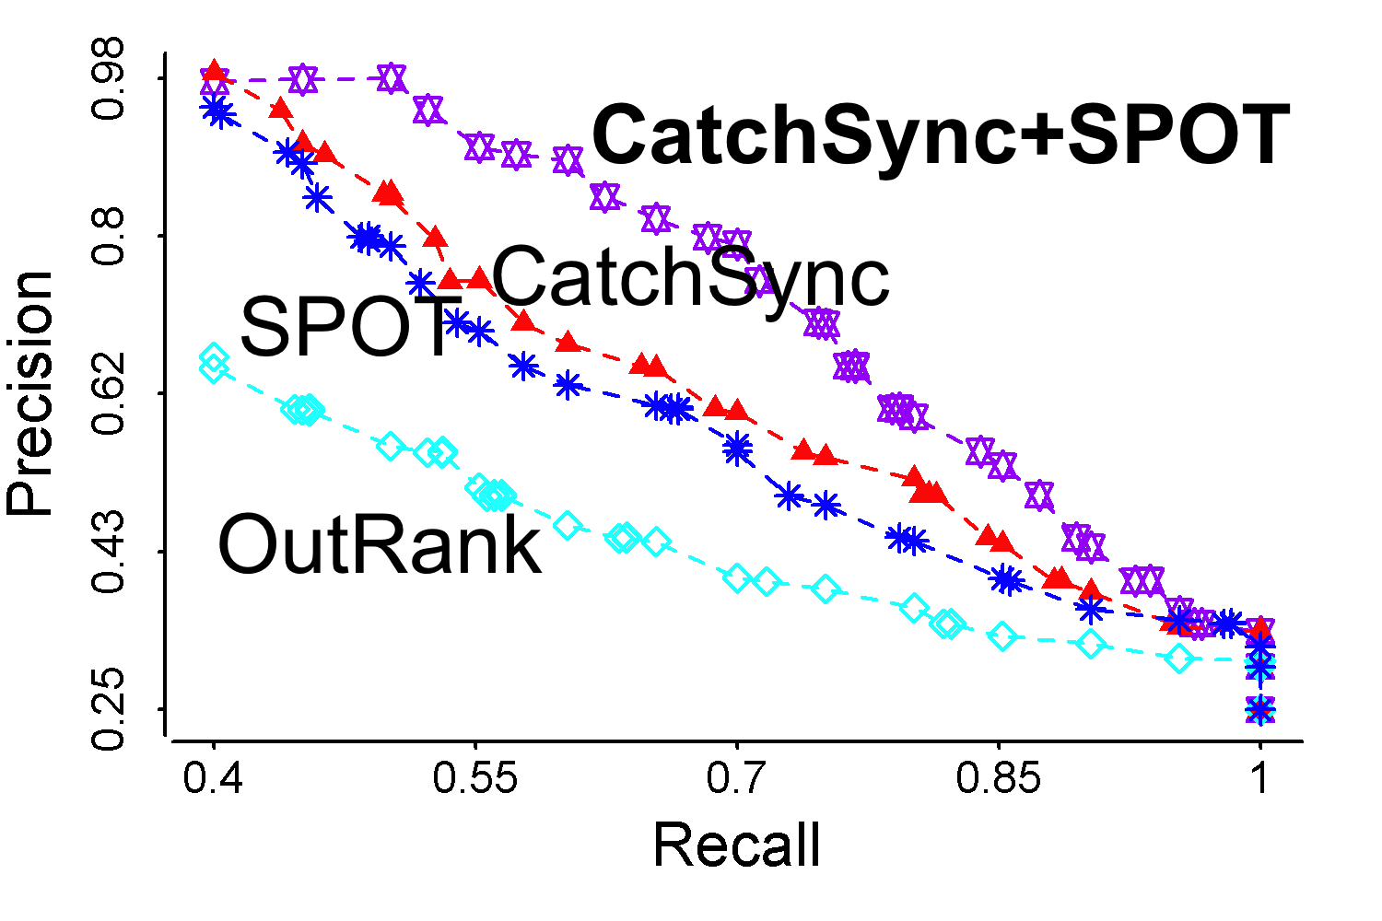
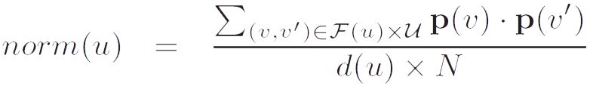
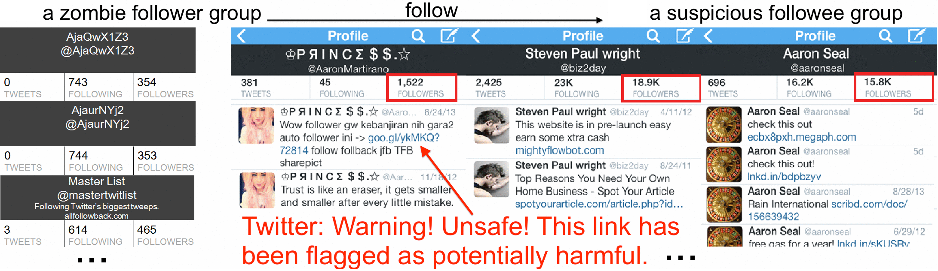
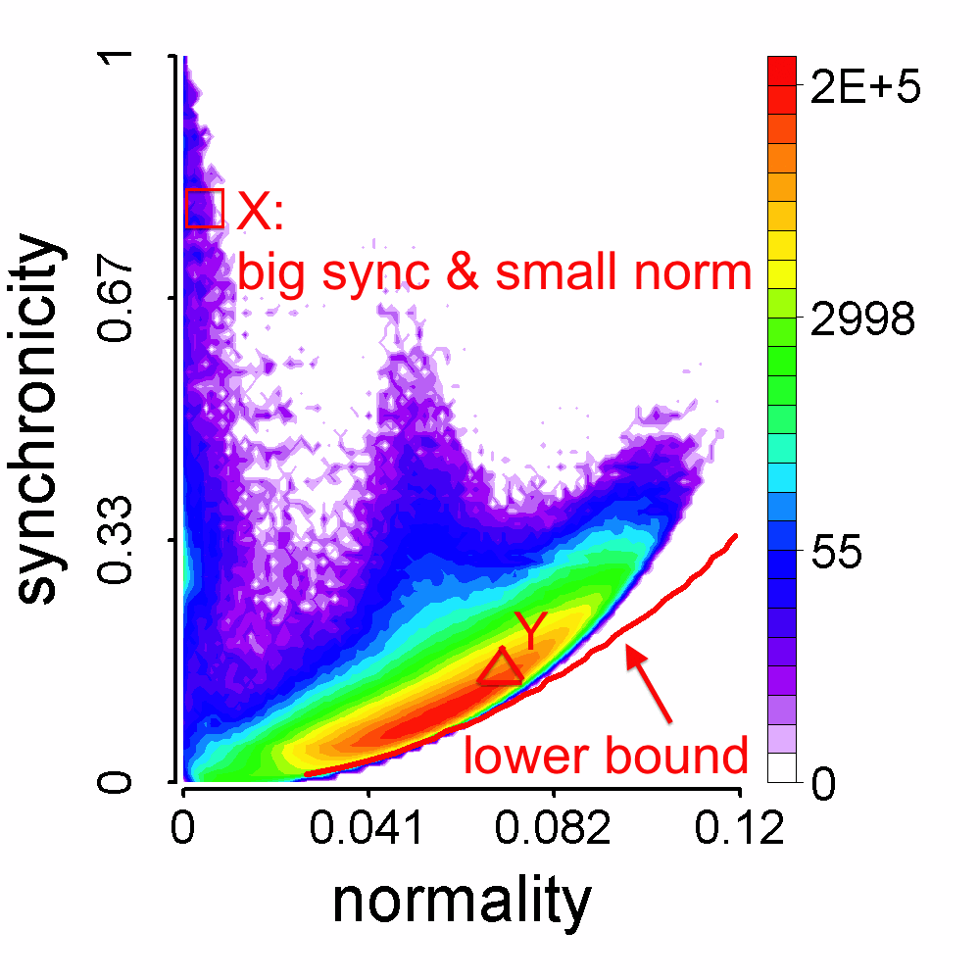


Detecting Suspicious Following Behavior in Multimillion-Node Social Networks Meng Jiang¹, Peng Cui¹, Alex Beutel², Christos Faloutsos², Shiqiang Yang¹ ¹ Department of Computer Science and Technology, Tsinghua University, Beijing, China ² Computer Science Department, SCS, Carnegie Mellon University, PA, USA
CATCHSYNC
Zombie Followers in “Who-Follows-Whom” Networks
Who are they? What do they do?
Fraudsters are paid to make certain accounts seem more legitimate or famous through giving them many additional followers.
They are often required to perform some tasks (e.g., follow the same group of users) together.
Deviations on out-degree distribution
3 million Twitter zombie followers create a spike at degree 20.
CatchSync restores normal (power-law-like and smooth) patterns.
Experimental Results on Synthetic Data
Injection on random power law graph
3M² + 5 groups (16K sources× 1.6K targets, 8K × 800, …, 1K × 100).
Camouflage: 10% more RANDom users; 50% top POPular idols.
Synchronicity-normality plots
Accuracy on 3M, 3M-RAND and 3M-POP
Precision-recall on 3M-RAND and 3M-POP
Suspicious Following Behavior Patterns
Synchronized: they have extremely similar behavior pattern.
Abnormal: their behavior patterns are different from the majority.
Feature space [HITS, Kleinberg et al., 1999]
Example:
User X: a zombie follower
User Y: an honest account
Out-degree values are the same: 20.
X’s hub (4.7×10⁻⁷) << Y’s hub (1.6×10⁻⁴)
X’s and Y’s targets (followees):
- X’s targets are too similar and very strange.
Followee | In-degree | Authority: high-quality celebrities/idols
Follower | Out-degree | Hub: containing links to famous idols
Experimental Results on Twitter and Tencent Weibo Data
Restore normal patterns in feature space/distributions
Accuracy, precision and recall on fraudsters
SPOT: content-based
CatchSync: graph-based
CatchSync OR(+) SPOT
Case Study
Synchronicity and Normality
Synchronicity: similarity between X’s targets.
Normality: similarity between X’s targets and other nodes.
* Features in vector p: (1) each source/target node; (2) structural features like centrality, eigenvectors; (3) side information like dates of birth, names.
Theorem For any distribution, there is a parabolic lower limit in the synchronicity-normality plot.
Proof. It is based on Lagrange multipliers.
- X has much bigger synchronicity and
smaller normality than Y (from majority).
CatchSync Algorithm: (1) feature space;
(2) sync and norm; (3) outlier detection.
Complexity analysis: O(E) – scalable.
Acknowledgement
Contact: Meng Jiang
<jm06@mails.tsinghua.edu.cn>

